Slide 1
TEAM 3 PRESENTATION
Team Name: CAPYBRUH
Team members:
Chuyen
Steven
Hong
Adam
Drake

Slide 2
THE GAME CONCEPT
Element 1
Element 2
Element 3
Element 4
Element 5
2D Top Down Shooter
Horror
Endless mode which will have A Scoring System
Multiplayer
Roguelike (if possible)

Slide 3
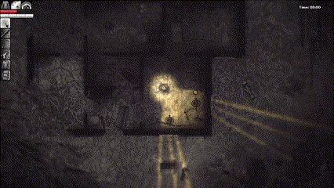
2. MECHANIC
Limited Vision: The player can only see in front of them.
Limited Vision: Player can only see things in front of them.

Slide 4
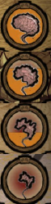
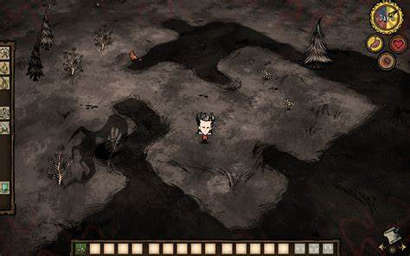
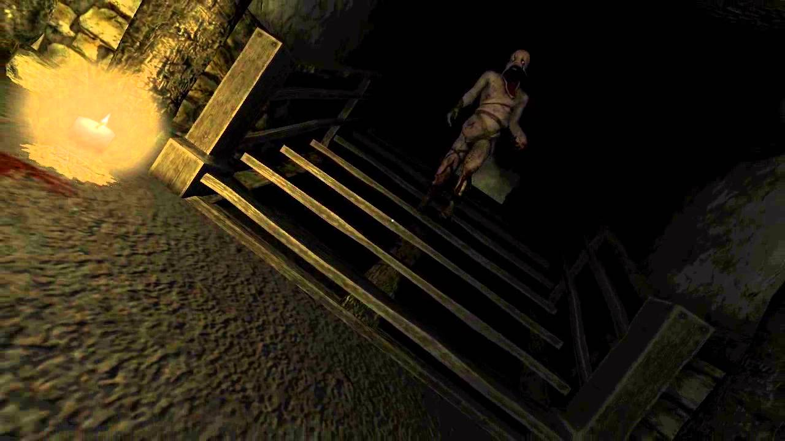
Sanity System: Player will have a sanity meter, which drop overtime. Low sanity can debuff the player, occasionally “stun”, allows special enemy to spawn…

Slide 5
WEAPON
WE ARE STILL DEBATING

Slide 6

1) Weapon Scaling System: The weapon get stronger as you kill more enemy. I.e: Player can have adding attachments like scopes, grips, or extended magazines that can improve accuracy, range, stability, etc.
WEAPONS
MODS: Increase DMG, add Elemental Effects, Special Attributes
LEVELING SYSTEM

Slide 7
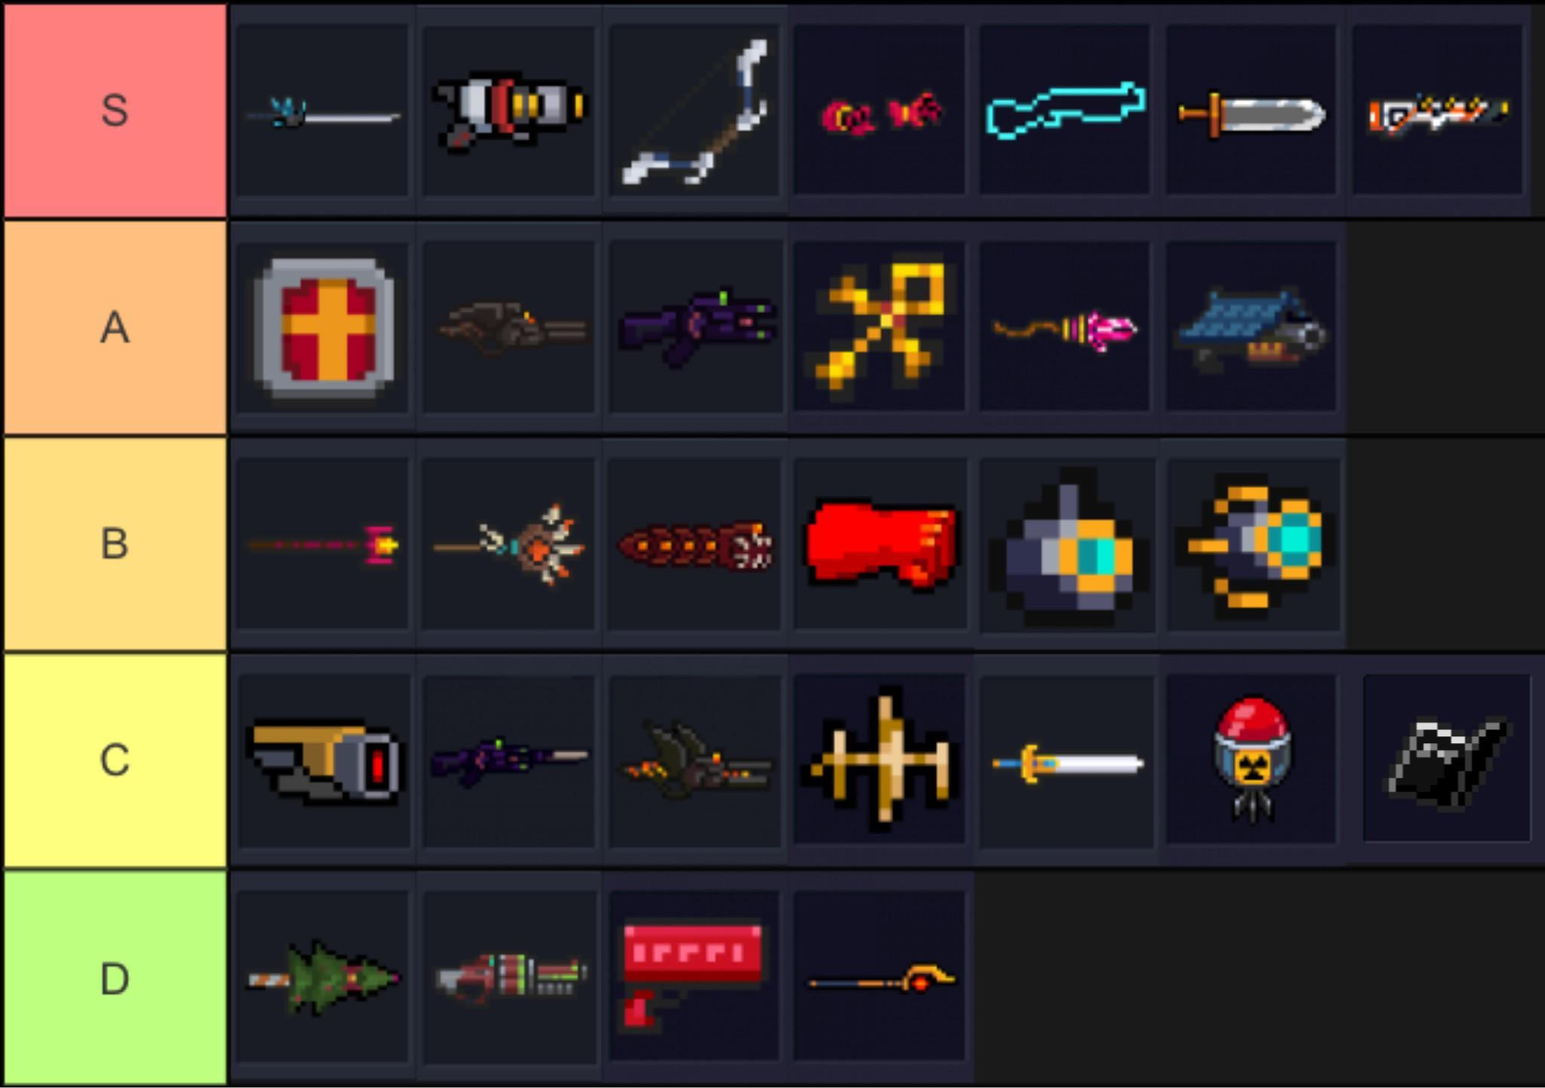
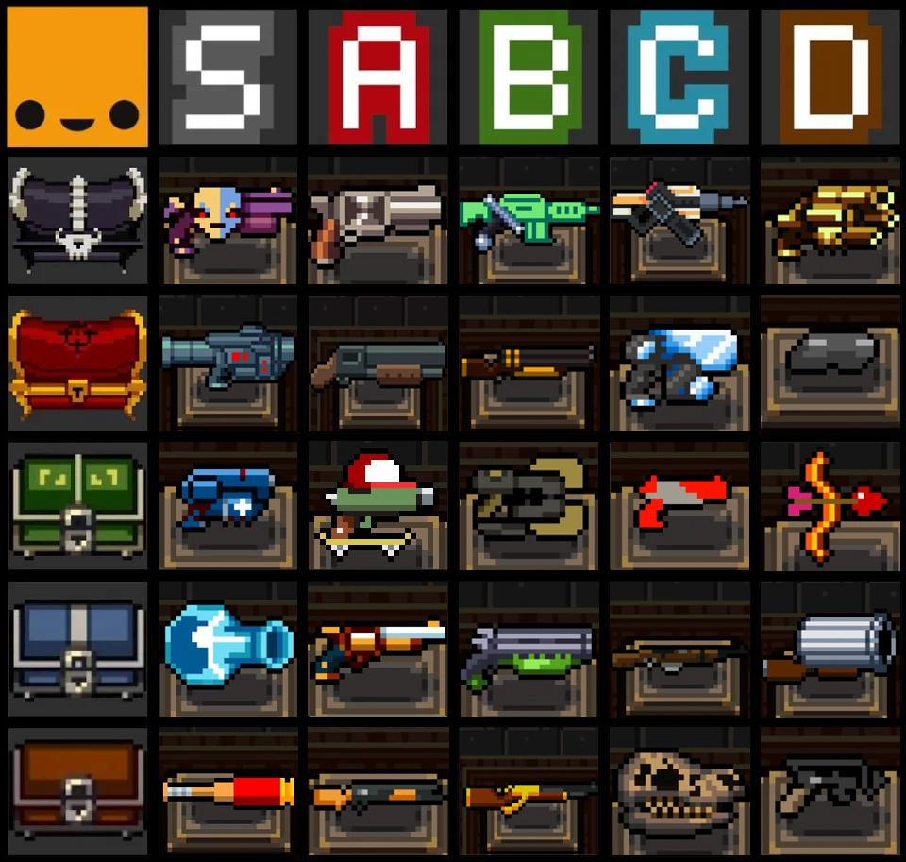
2) Weapon PICK-UP:
player can find chest and open with a chance of common/rare/legendary or D/C/B/A/S weapon
Or buy it from a store
Example:
Soul Knight
Enter the Gungeon

Slide 8
OTHER FEATURE
Scoring system
Environmental interaction (ex: trap…)
Simple AI that handle enemies and items spawn
Basic movements with the ability to dodge (with i-frames -> stamina system)

Slide 9
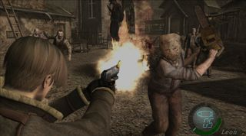
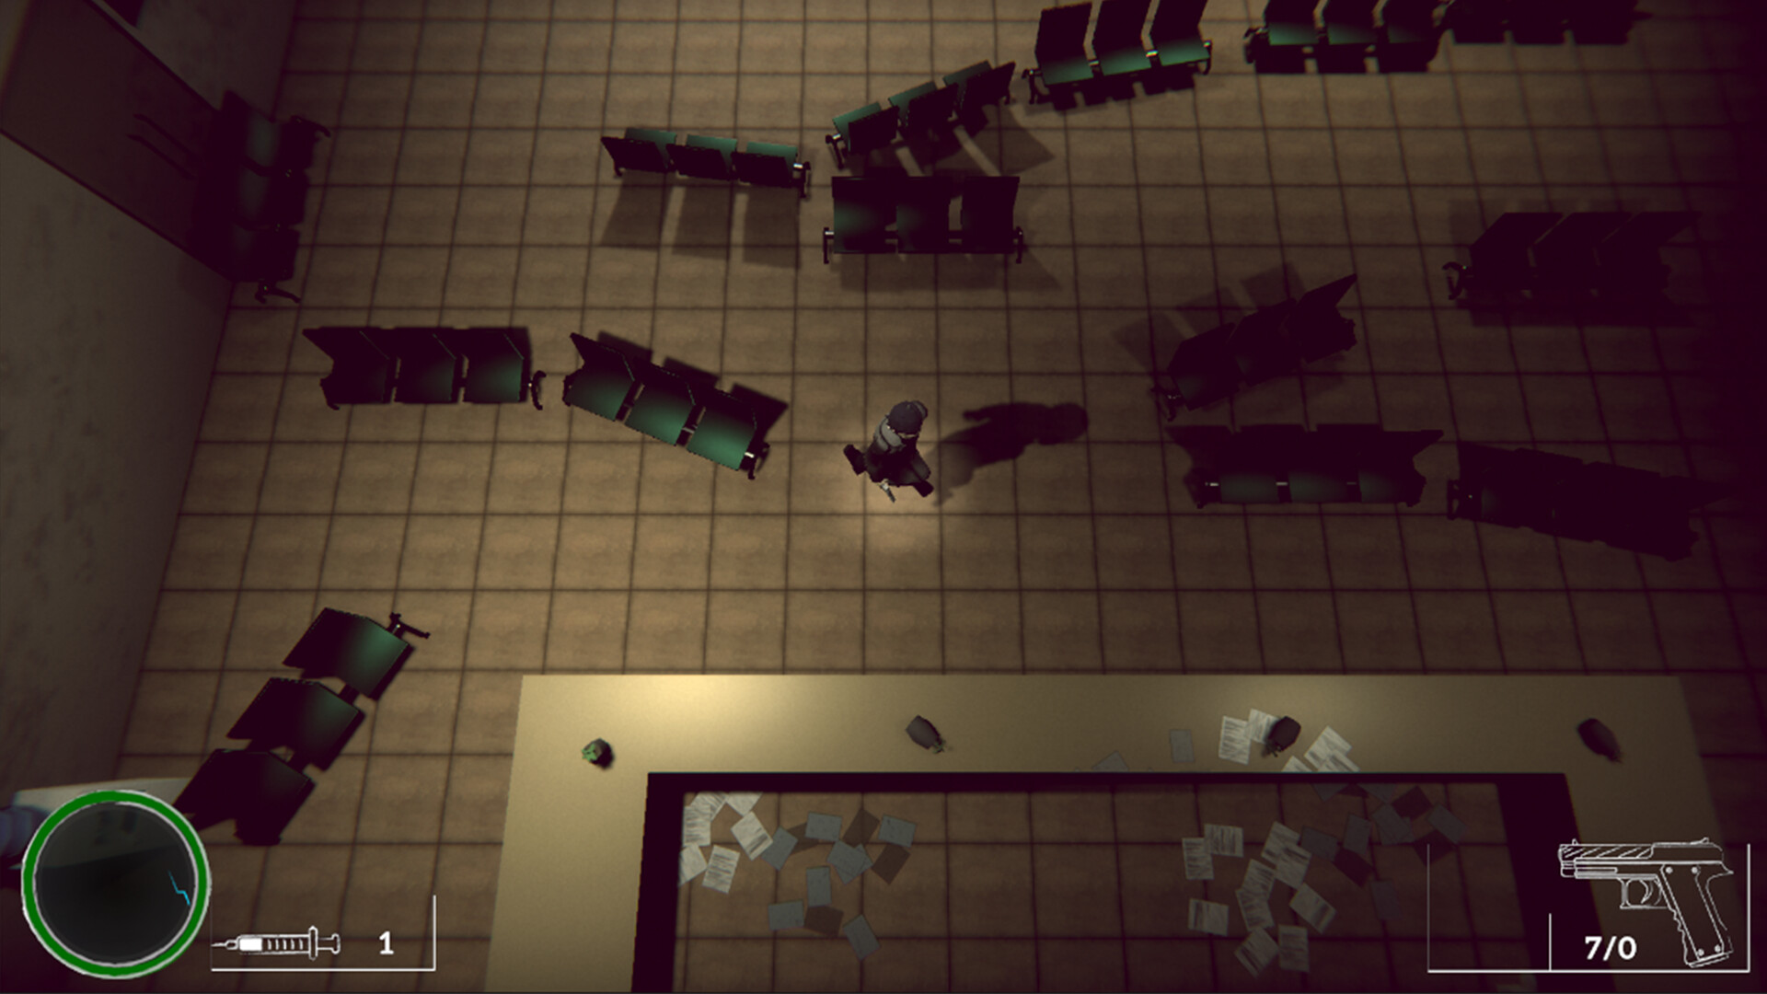
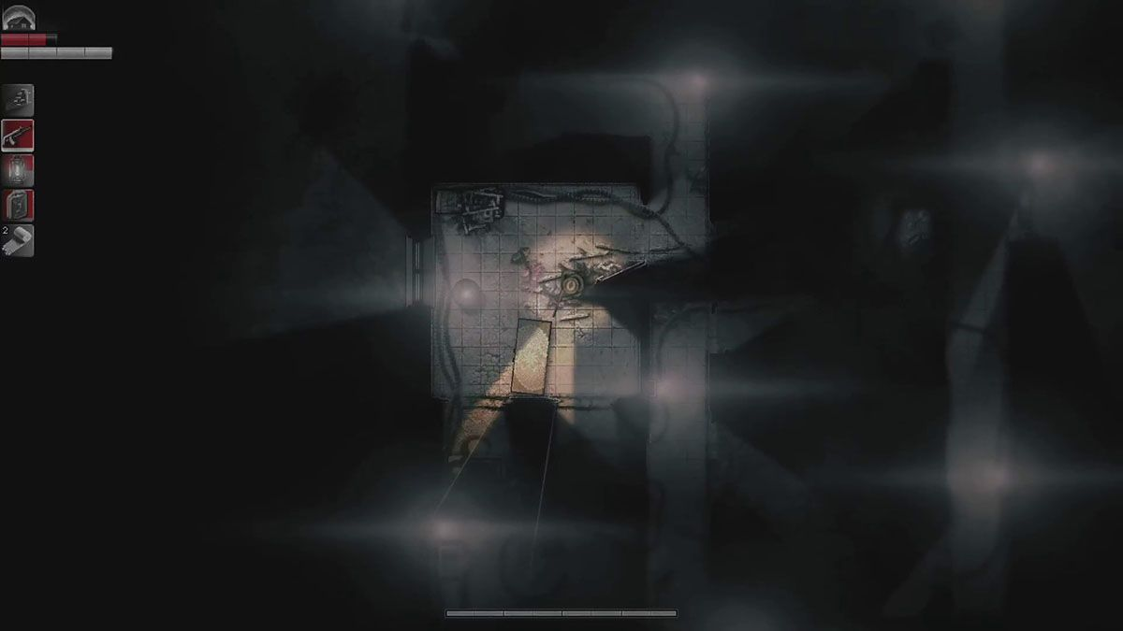
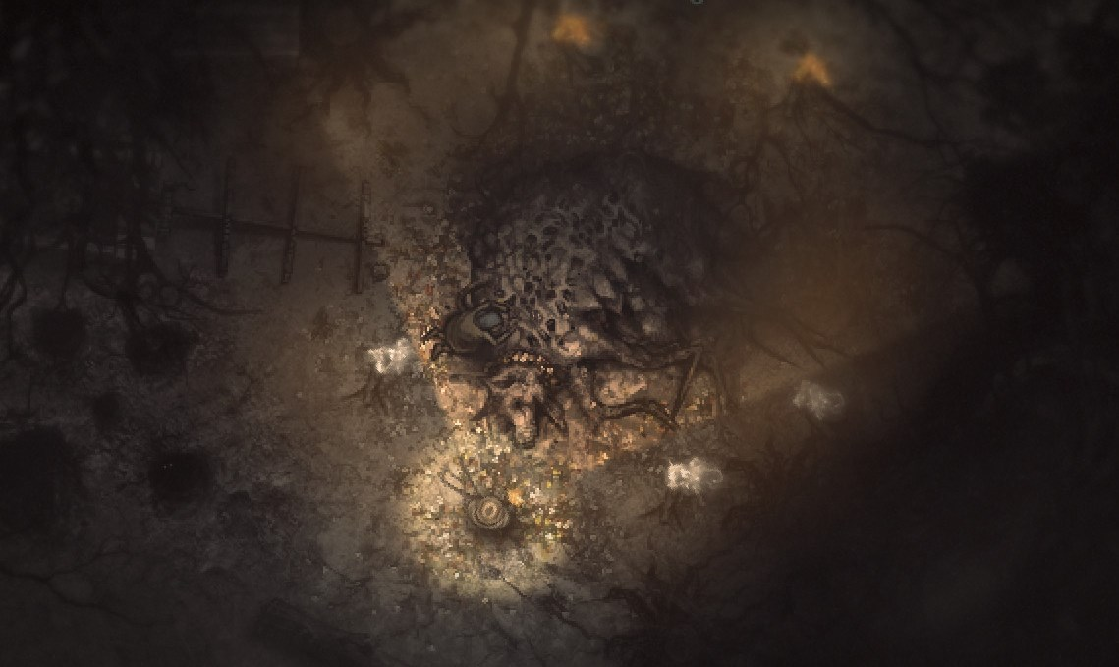
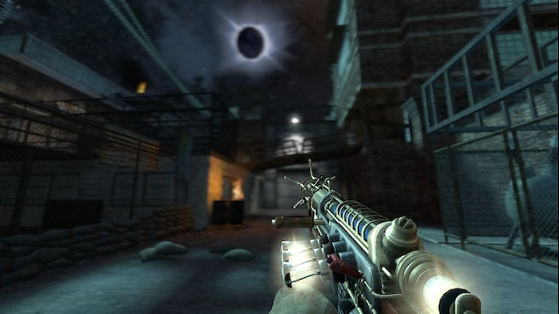
Art Mood Board
Map themes:brown,gray, black
Weapon themes:Rustic, CoD zombies like to account for upgrades

Slide 10
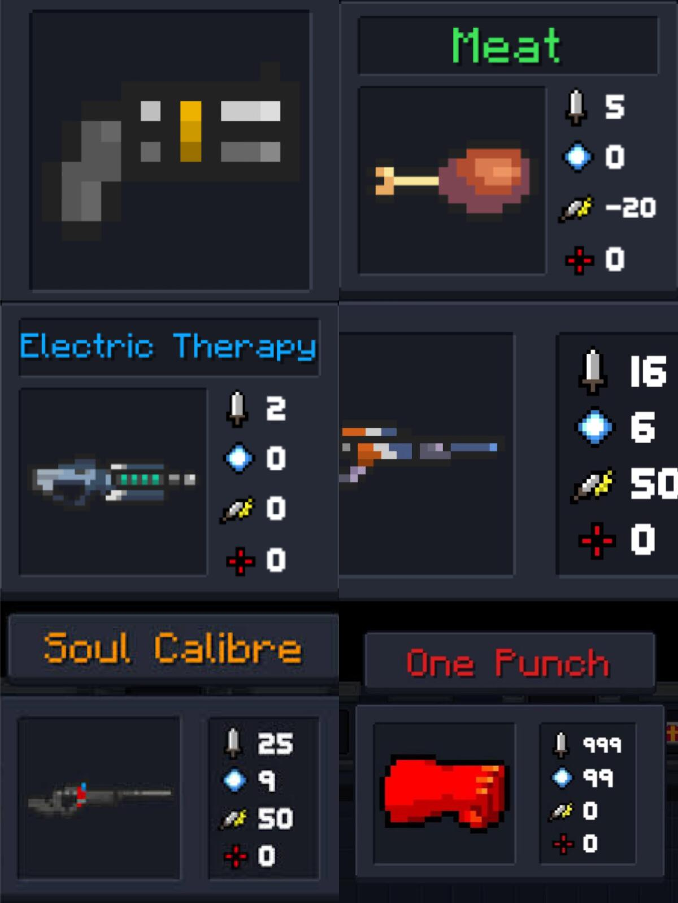
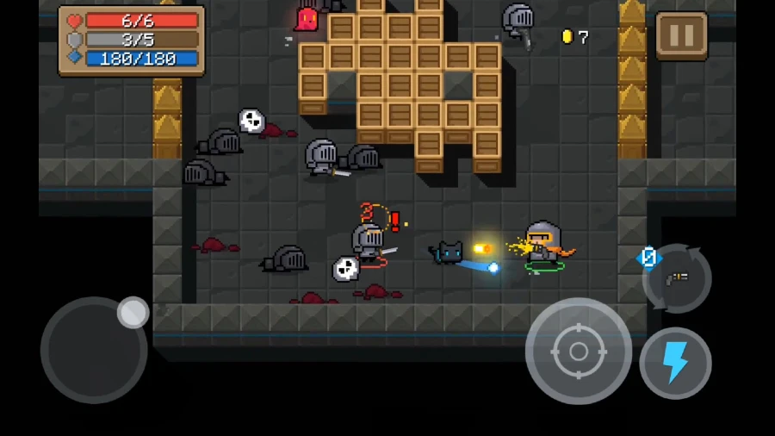
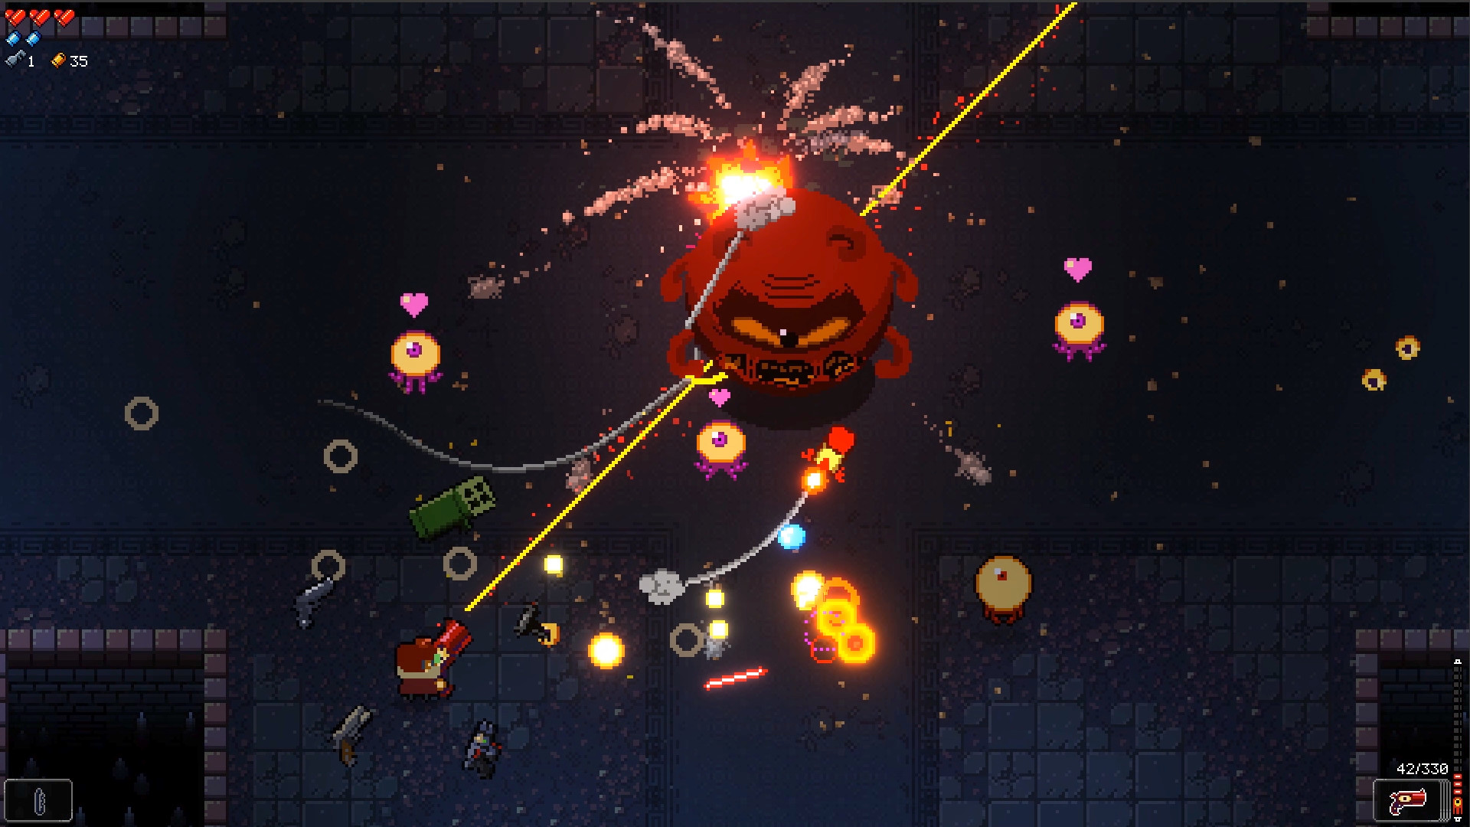
Art Assets
We are currently looking for free and suitable art asset that work well with our game:
Mainly 8-bit like Soul Knight
or sth clean like Enter the Gungeon

Slide 11
THANK YOU FOR LISTENING!
QUESTIONS ?

